Slide 1
Dice Roller
Streamlining Tabletop Gaming Experiences
By Robert Land

Slide 2

The Problem
Disruption of Gameplay
Lack of Transparency
Incomplete Record-keeping
Challenges faced by tabletop gaming enthusiast when rolling physical dice

Slide 3

The Solution: Dice Roller
Web-Based application designed to address the challenges of physical dice rolling
Key features:
Intuitive Dice Rolling
Roll History
Seamless Integration
Transparency and Fairness
This Photo by Unknown Author is licensed under CC BY-NC

Slide 4

Use cases
Rolling dice for various tabletop games (e.g., Dungeons & Dragons, Settlers of Catan)
Keeping track of previous rolls during a gaming session
Sharing dice roll results with other players in real-time
This Photo by Unknown Author is licensed under CC BY-SA-NC

Slide 5
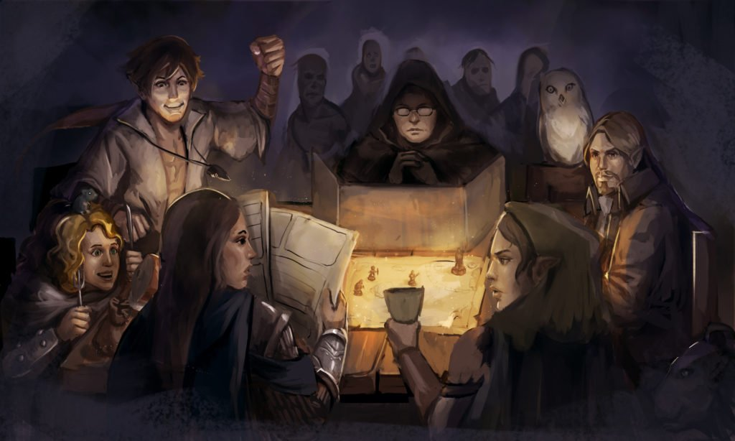
User Stories
"As a Dungeons & Dragons player, I want to be able to roll dice digitally to avoid disrupting the flow of the game."
"As a board game enthusiast, I want to maintain a history of my dice rolls to review and analyze my past performance."
"As a game master, I want to provide a transparent and fair dice rolling experience for my players to ensure the integrity of the game."
This Photo by Unknown Author is licensed under CC BY

Slide 6
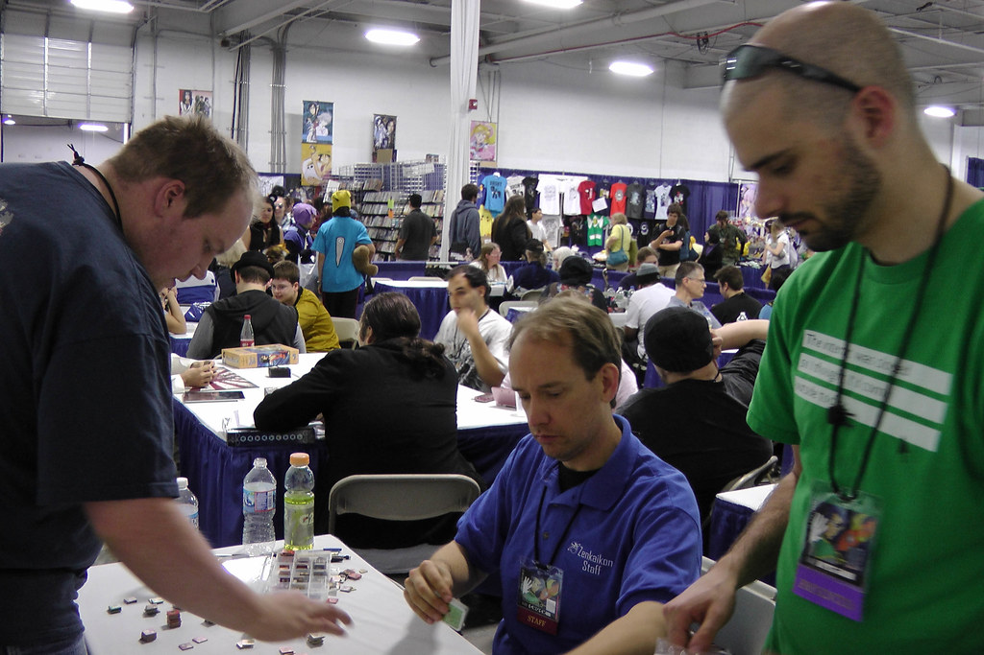
Target Market and Opportunity
Vast and growing community of tabletop gaming enthusiasts
Global tabletop gaming market expected to reach $12 billion by 2026
This Photo by Unknown Author is licensed under CC BY

Slide 7
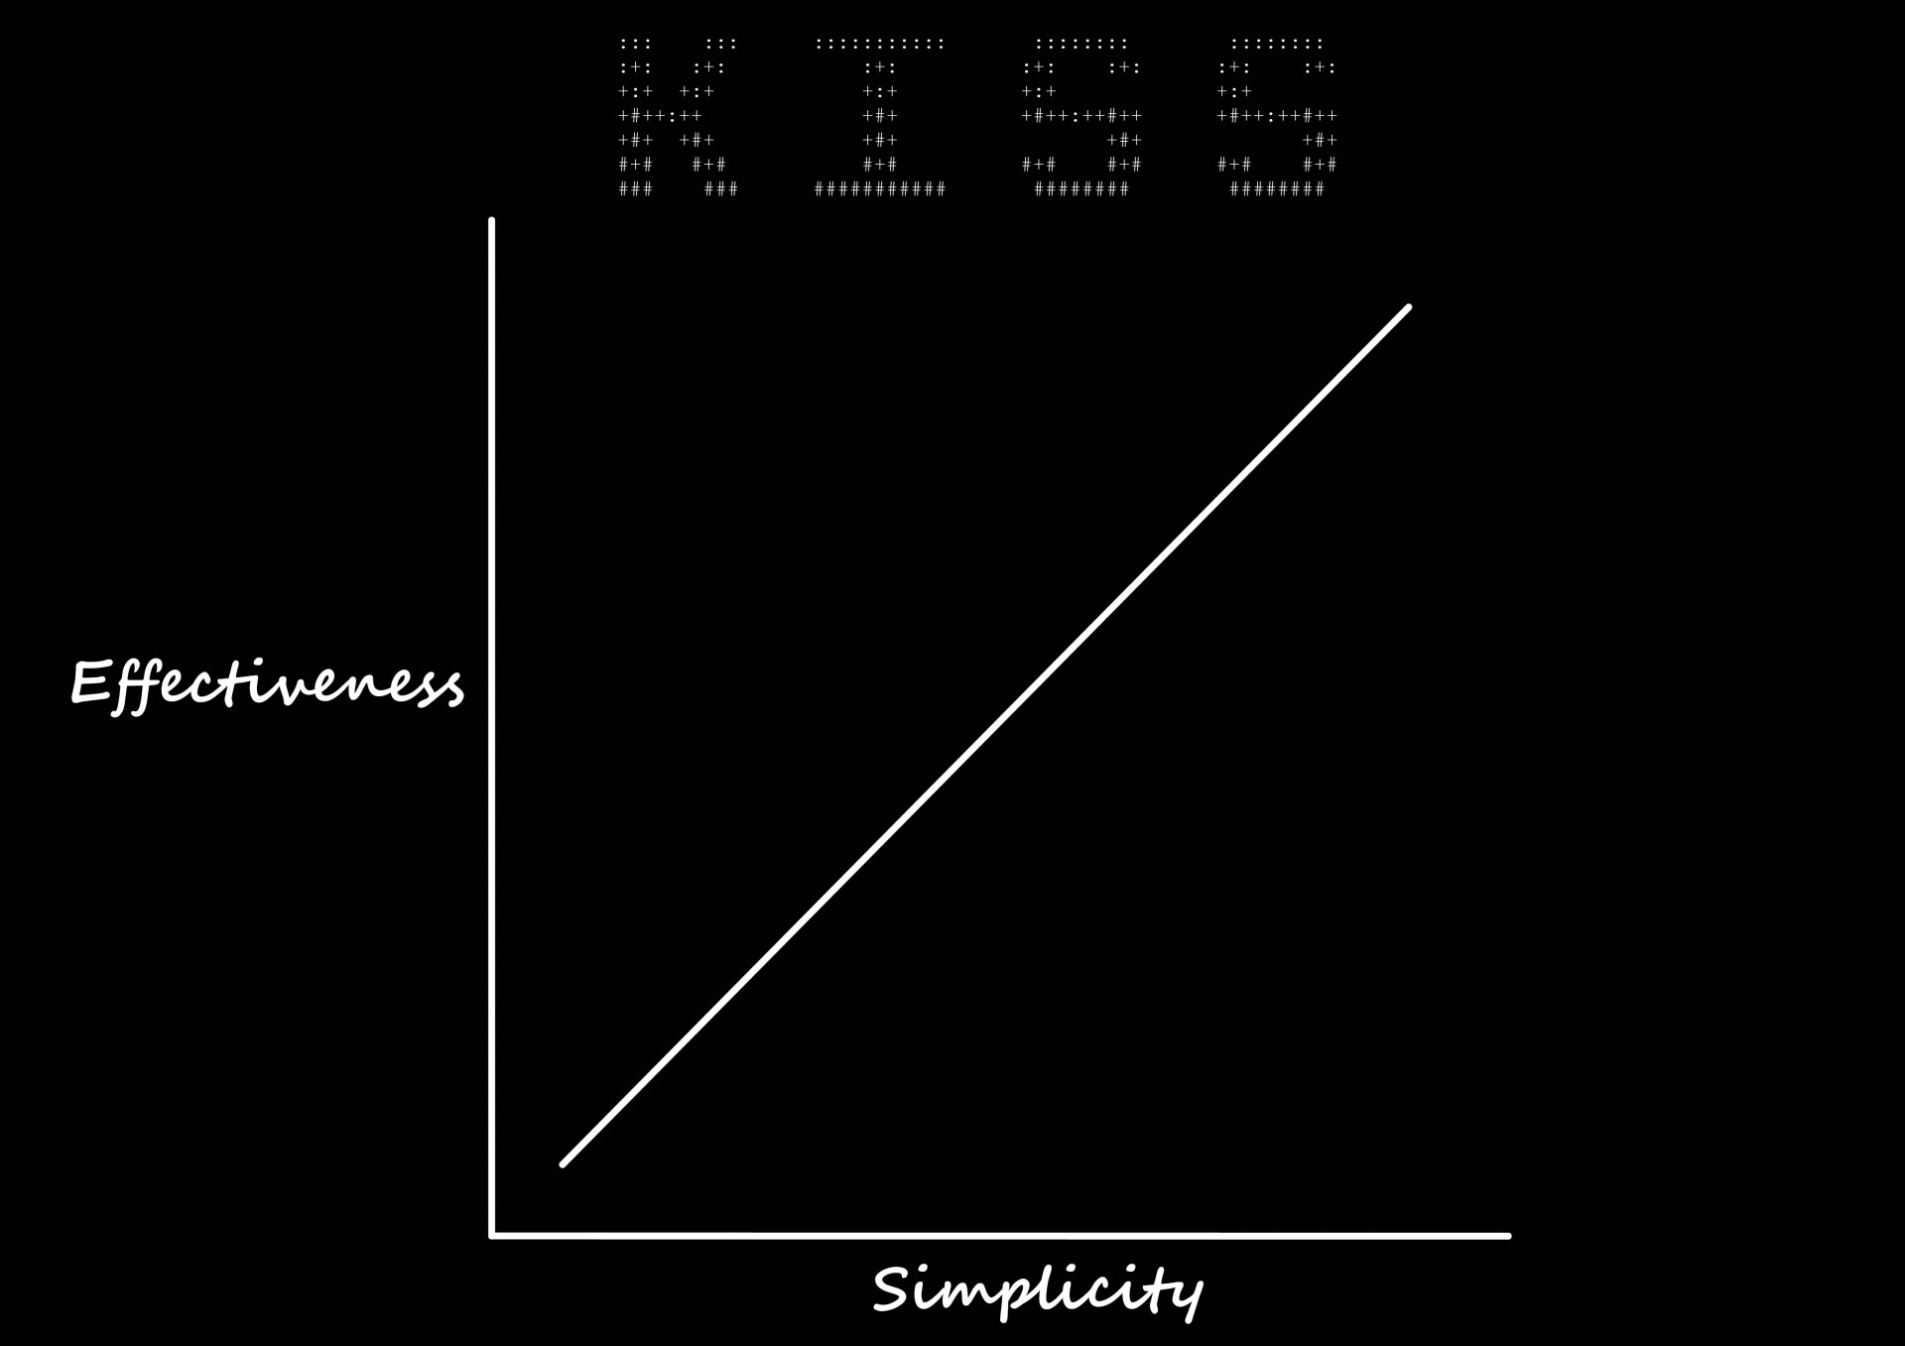
Competitive Advantage
Simplicity, user-friendliness, and seamless integration

Slide 8
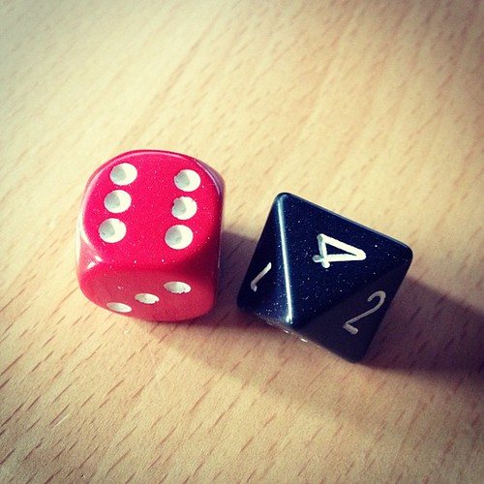
Why Dice Roller?
Addresses pain points of physical dice rolling
Enhances the overall gaming experience
This Photo by Unknown Author is licensed under CC BY

Slide 9
Conclusion
Dice Roller presents a compelling opportunity to improve the tabletop gaming experience
Focus on user experience, seamless integration, and sustainable design

